Slide 1
Thermal Camera Imaging with machine learning using a raspberry pi
Nnnn nnnn
Mashal Tareen
M00740589

Slide 2
Presentation Outline
Problem definition
Background
Prototype requirements
Development methodology
Testing and Evaluation
Improvement cycle

Slide 3
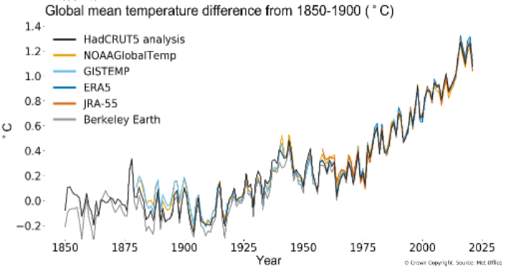
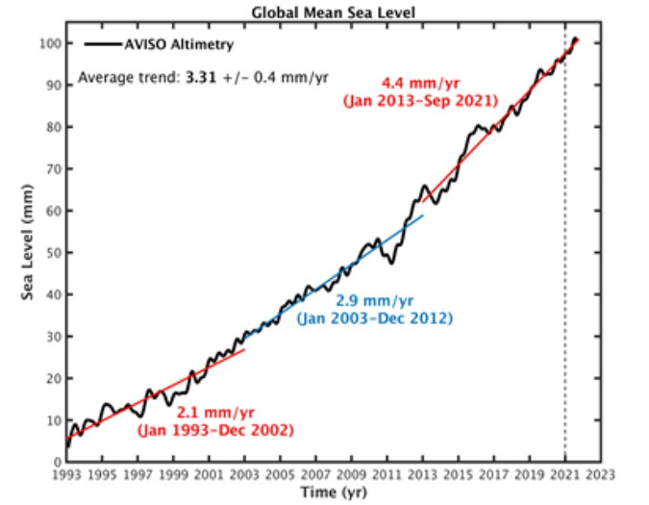
Problem definition
Global warming
Fig. 2. Global mean sea level [2]
Fig. 1. Global mean temperature [2]

Slide 4
Background/Introduction
Machine learning is a sunset of artificial intelligence that masters in making decisions based on data provided and finding patterns using different algorithms without much human intervention [1].
Supervised learning: Neural networks, Linear regression
Unsupervised learning: Clustering, Anomaly detection.

Slide 5
Prototype requirements
The camera should be able to take snapshots
Use machine learning in predicting the presence of a human
Notes:
The prototype should be able to function under these scenarios

Slide 6
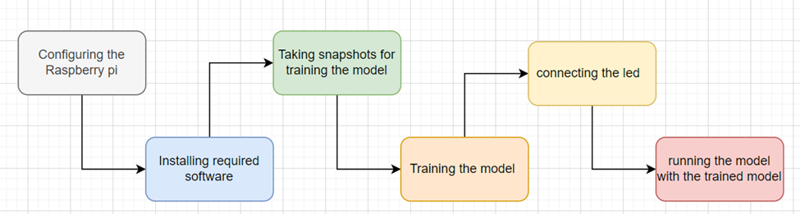
Development Methodology
Waterfall Method was used to construct the proposed prototype
Implementation using the block diagram

Slide 7
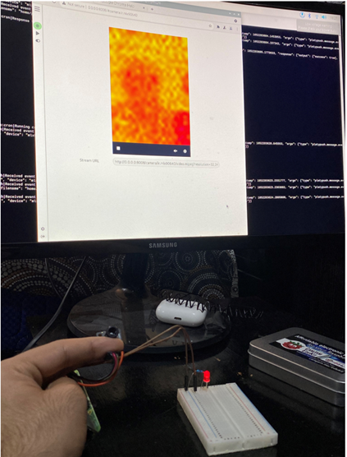
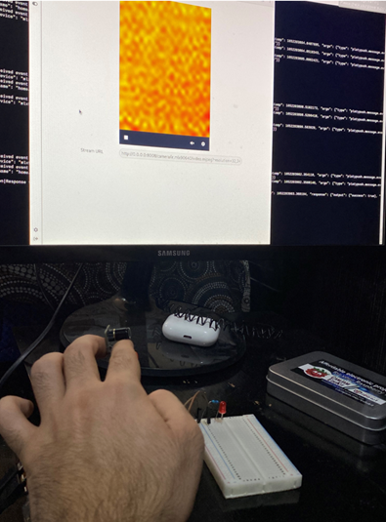
Testing and Evaluation
Room lights turned on

Slide 8
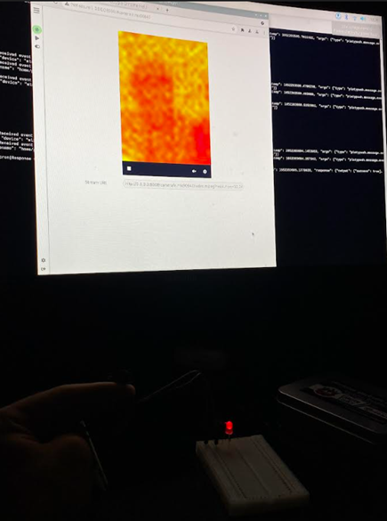
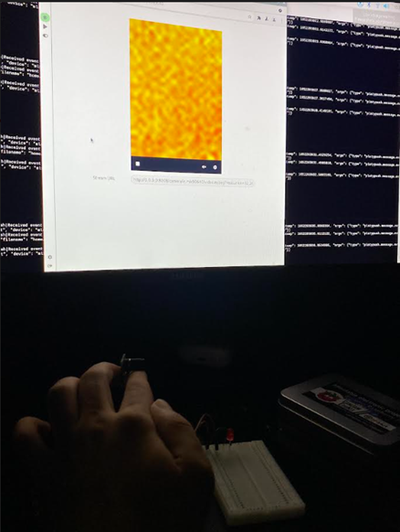
Room lights turned off

Slide 9
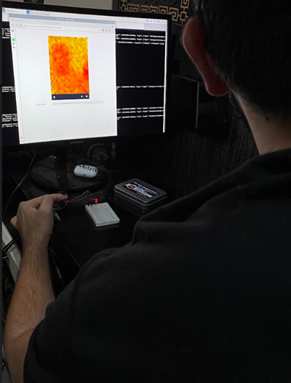
Wearing dark clothes

Slide 10
Improvement Cycle
Use a more powerful computer
Alos Use for security purposes
Use More advanced thermal camera
Use of light bulb instead of a small LED using IOT
Implement a logic that also counts the number of people in a room

Slide 11
References
[1] Mohri, M., Rostamizadeh, A. and Talwalkar, A, 2018. Foundations of machine learning. MIT press.
[2] World Meteorological Organization. 2021. State of Climate in 2021: Extreme events and major impacts. [online] Available at: <https://public.wmo.int/en/media/press-release/state-of-climate-2021-extreme-events-and-major-impacts> [Accessed 9 May 2022].

